Slide 1





Session 2-3
Optimization of Detailed Combustion Mechanisms
Tibor Nagy
HUN-REN Research Centre for Natural Sciences, Budapest, Hungary
CYPHER − COST Action CA22151
Training School on the analysis, uncertainty quantification, validation,optimization and reduction of combustion kinetic mechanisms
September 2-5, 2025 − Budapest, Hungary

Slide 2
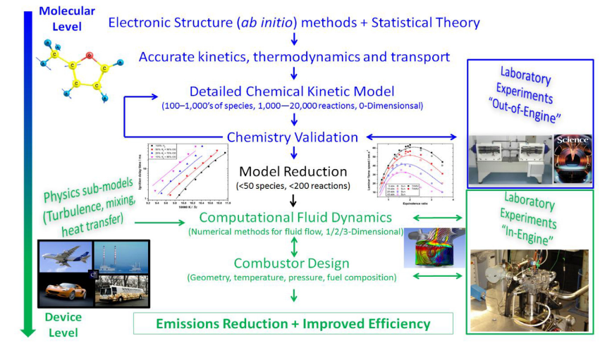
Designing combustion devices
Direct measurements
Indirect measurements
Model tuning
H. J. Curran, Proc. Combust. Inst., 2019, 37, 57–81. (with extension and highlighting in red)
Even the best theoretical calculations are still not accurate enough to construct fully predictive models, and the models are often incomplete; however, parameter optimization can significantly improve their reliability and applicability.
Notes:
How do we introduce a new fuel or engine type?
First, we create a kinetical model from theoretical calculations, and „direct measurements”, which focus on the rate parameters of a single reaction!
Then we optimize and validate this model against „indirect measurements”, which cover more complex processes.
The reduction (20+ times magnitude) of this model allows more complicated simulations, such as engine modelling.

Slide 3
Elements of kinetic model optimization
1. Indirect experimental data and their uncertainty (see earlier)
Definine your fuel and application-relevant conditions
Collect indirect experimental data to serve as reference
Re-evaluate the uncertainty of the collected data
⇒ optimization targets ⇒ the error function
2. Kinetic model validation and comparison (see earlier)
Collect reaction mechanisms from the literature
Evaluate performance and identify the best model for your system
⇒ best model to improve upon
3. Prior uncertainty of rate parameters (see earlier)
Collect direct experimental data and theoretical determinations
Determine the prior uncertainty ranges of the rate parameters
⇒ targets and parameter ranges for global optimization
4. Parameter optimization and evaluation of posterior uncertainties
Identify the most influential parameters using sensitivities and uncertainties
Optimize them within their uncertainty ranges
Estimate posterior uncertainty ranges of the optimized parameters
5. Case studies on kinetic parameter optimization with specific characteristics
To
d
ay

Slide 4
History of mechanism optimization
First mechanism optimization study in combustion:
Michael Frenklach, Combust. Flame, 58, 69-72 (1984)
M.Frenklach, H.Wang, M.J. Rabinowitz, Prog.Energy Combust.Sci.,18,47-73 (1992)
  Optimizing pre-exponential factor (A) and thermodynamic parameters within uncertainty ranges to improve the agreement of the simulation results with the experimental data.
⇒ GRI mechanism 3.0 (1999) - a benchmark model for natural gas and NOx
Later pioneering methods and tools (without completeness)
Method of Uncertainty Minimization Using Polynomial Chaos Expansions
D. Sheen, X. You, H. Wang, T. Løvås: Proc. Combust. Inst., 32, 535-542 (2009)
D. Sheen, H. Wang: Combust. Flame, 158, 645-656 (2011)
L. Cai, H. Pitsch: Combust Flame, 161, 405–15 (2014), 162, 1623–37 (2015)
Optima (Optima++) - uncertainty and optimization of all Arrhenius parameters
T. Nagy and T. Turányi: Int.J.Chem.Kinet, 43, 359-378 (2011)
T.Turányi,T. Nagy, I.G. Zsély, M. Cserháti,T. Varga,et al., B.T. Szabó, I. Sedyó,
P.T. Kiss, A Zempléni, HJ Curran, Int.J.Chem.Kinet,44,284-302 (2012)
M.Papp, T.Varga, Á. Busai, I.G. Zsély,T. Nagy, T. Turányi, Optima++ v. 2.5 (2025)
OptiSMOKE++ - curve matching optimization (see later)
OptiSMOKE++: A toolbox for optimization of chemical kinetic mechanisms (2021)
M. Fürst, A. Bertolino, A. Cuoci, T. Faravelli, A. Frassoldati, A. Parente
Comput. Phys. Commun. 264 (2021) 107940.

Slide 5
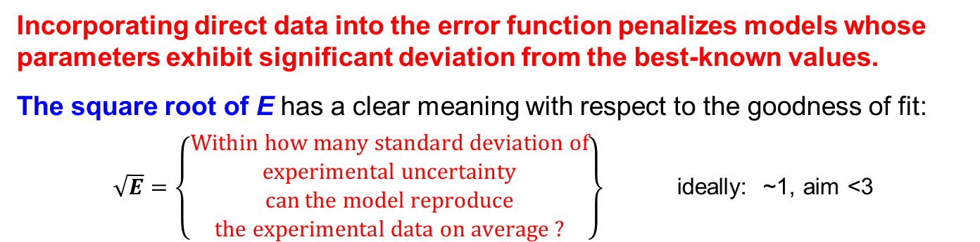
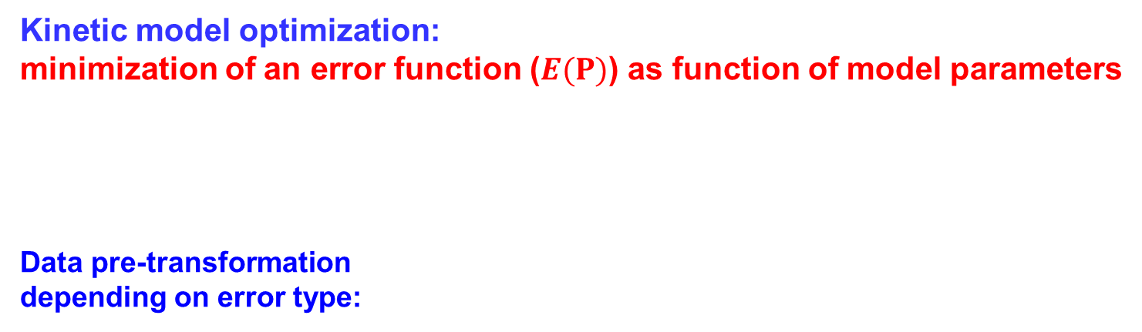

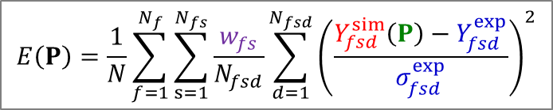
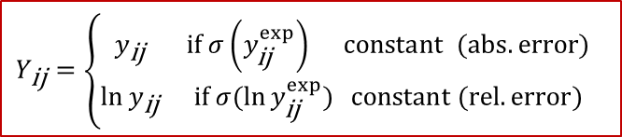
Topic I: Optimization with Optima/Optima++
Kinetic model optimization:
minimization of an error function ($E(P)$) as function of model parameters
Data pre-transformation
depending on error type:
$$E\left(P\right)=\frac{1}{N}\sum_{f=1}^{N_{f}}{\sum_{s=1}^{N_{fs}}{\frac{w_{fs}}{N_{fsd}}\sum_{d=1}^{N_{fsd}}{{\left(\frac{Y_{fsd}^{sim}\left(P\right)−Y_{fsd}^{exp}}{σ_{fsd}^{exp}}\right)}^{2}}}}$$
$Y_{fsd}^{exp}$, $Y_{fsd}^{sim}$ (transform.) experimental data
and corresp. calculated value
Both indirect and direct (rate coeffs.) data.
For validation only indirect data was used !
$P$ vector of parameters (e.g., $\ln{A_{i}},n_{i},\frac{E_{i}}{R})$
$σ_{fs}^{exp}$ uncertainty of experimental data series
$w_{fs}$ additional weights (default:1)
$$Y_{\text{ij}}=\left\{\begin{matrix}y_{\text{ij}} & \text{if} σ\left(y_{\text{ij}}^{exp}\right) \text{constant} \text{(}\text{ab}s. error) \\ \ln{y_{\text{ij}}} & \text{if} σ(\ln{y_{\text{ij}}^{exp})} \text{constant} (rel. error)\end{matrix}\right.$$
Incorporating direct data into the error function penalizes models whose parameters exhibit significant deviation from the best-known values.
The square root of E has a clear meaning with respect to the goodness of fit:
$\sqrt{E}=\left\{\begin{aligned}Within how many standard deviation of \\ experimental uncertainty \\ can the model reproduce \\ the experimental data on average ?\end{aligned}\right\}$ ideally: ~1, aim <3

Slide 6

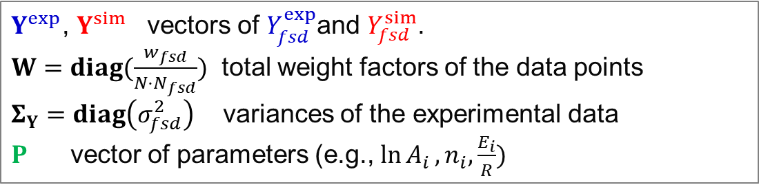
Posterior covariance matrix
The error function can be recast into matrix-vector form:
At the optimum ($P_{o}$), the posterior uncertainty (covariance matrix) of the parameters is estimated by propagating the mean-squared deviation of model predictions from the experimental data ($Σ_{Δ}$), together with the experimental uncertainty ($Σ_{Y}$), to the parameters using the local sensitivity matrix (${ J}_{o}$) and additional weight factors ($W,$ $Σ_{Y}$ ).
${ J}_{o}={\left(\frac{dlnY^{sim}}{dP}\right)}_{P_{o}}$Jacobi (local sensisitivity) matrix at the optimum
$Σ_{Δ}=diag\left({mean}_{d}Δ_{fsd}^{2}\right)$, $Δ_{fsd}=Y_{fsd}^{sim}\left(P_{o}\right)−Y_{fsd}^{exp}$: model deviations from exp. data.
$$E\left(P\right)={\left(Y^{sim}(P)−Y^{exp}\right)}^{T}WΣ_{Y}^{−1}\left(Y^{sim}(P)−Y^{exp}\right)$$
$Y_{ }^{exp}$, $Y_{ }^{sim}$ vectors of $Y_{fsd}^{exp}$and $Y_{fsd}^{sim}$.
$W=diag(\frac{w_{fsd}}{{N⋅N}_{fsd}})$ total weight factors of the data points
$Σ_{Y}=diag\left(σ_{fsd}^{2}\right)$ variances of the experimental data
$P$ vector of parameters (e.g., $\ln{A_{i}},n_{i},\frac{E_{i}}{R})$

Slide 7

Parameters and simulation results
space of rate parameters
space of simulation results
model
nominal parameter set of the kinetic model
simulation result

Slide 8
Considering the uncertainties
space of rate parameters
space of simulation results
model
prior uncertainty
of the rate parameters
from the direct measurements
simulation result

Slide 9
Uncertainty of simulation results
space of rate parameters
space of simulation results
model
prior uncertainty
of the rate parameters
from the direct measurements
domain of uncertainty
of the simulation results

Slide 10
Simulation uncertainty vs.
indirect measurement uncertainty
space of rate parameters
space of simulation results
model
simulation result
after optimization
parameters
after optimization
prior uncertainty
of the rate parameters
domain of uncertainty of the indirect/direct measurements

Slide 11
Parameter optimization – constraining the model
space of rate parameters
space of simulation results
model
Deviation from
experimental data
posterior uncertainty
of the rate parameters due to experimental data uncertainty
and model–data deviations
domain of uncertainty of the indirect/direct measurements

Slide 12
Results of optimization
Optimized detailed reaction mechanism
  It usually describes the experimental data much better.
Set of optimised rate parameters
  All rate parameters are within the prior uncertainty domain.
Posterior covariance matrix of the optimised parameters
  ⇒ f(T) uncertainty function of each optimised rate coefficient
  ⇒ correlation coefficients between pairs of rate coefficients
  Ideally, the posterior uncertainty ranges are narrower than the priors.
The optimized model may serve as a core mechanisms for larger fuels ⇒ optimization should be done hierarchically from down to up.
The same optimisation methodology can be used for
⇒ interpretation of indirect experimental data
developing better detailed combustion mechanisms
developing predictive, incomplete models with non-physical parameters for CFD applications.

Slide 13
Example: CH₃OH/HCHO mechanism
  Starting mechanism: modified Li et al. (2007) methanol, updated with ELTE-2016 syngas mechanism.
  Optimization targets (24,900 data points):
    517 Shock tube ignition delay points
    59 RCM ignition delay points
    153 Laminar burning velocity points
    2,508 Flow reactor species concentration points
    706 Jet-stirred reactor species concentration points
    20,460 Shock tube species concentration points
    926 Direct measurements of reaction rate coefficients
    33 Theoretical determinations of reaction rate coefficients
17 important reactions (57 Arrh. parameters) were identified
Polynomial surrogate model (“response surfaces”)
used only for the computationally expensive flame simulations
C. Olm, T. Varga, É. Valkó, H.J. Curram. T. Turányi: Combustion and Flame 186 (2017) 45–64

Slide 14
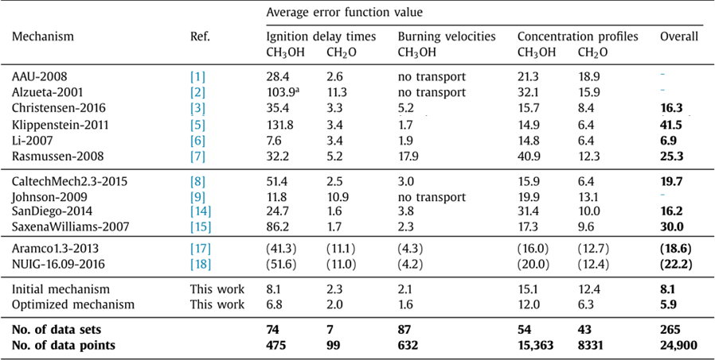
Example: CH₃OH/HCHO mechanism
Minimization of the error function
(Not showing the 6 worst mechanisms out of 18.)
The optimization reduced the error significantly: E=8.1 → 5.9 and gave the best model, which was also the most accurate for H₂/CO at the time of publication.

Slide 15
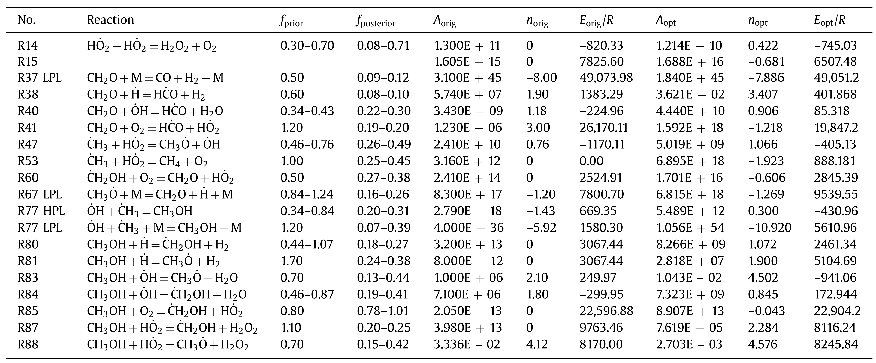
Example: CH₃OH/HCHO mechanism
New parameters with reduced uncertainties

Slide 16
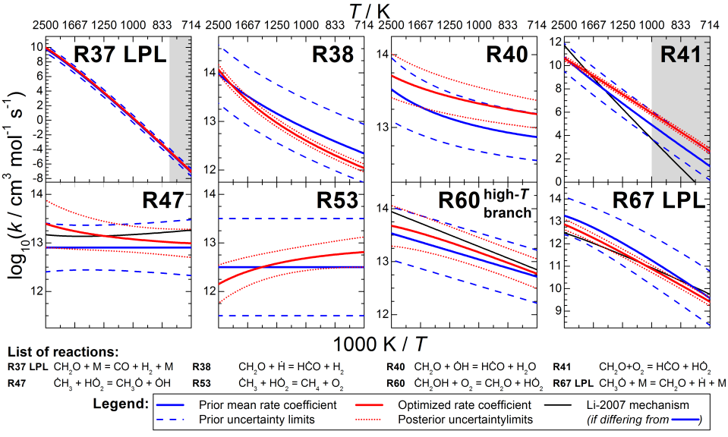
Example: CH₃OH/HCHO mechanism
Prior and posterior Arrhenius curves+uncertainties

Slide 17
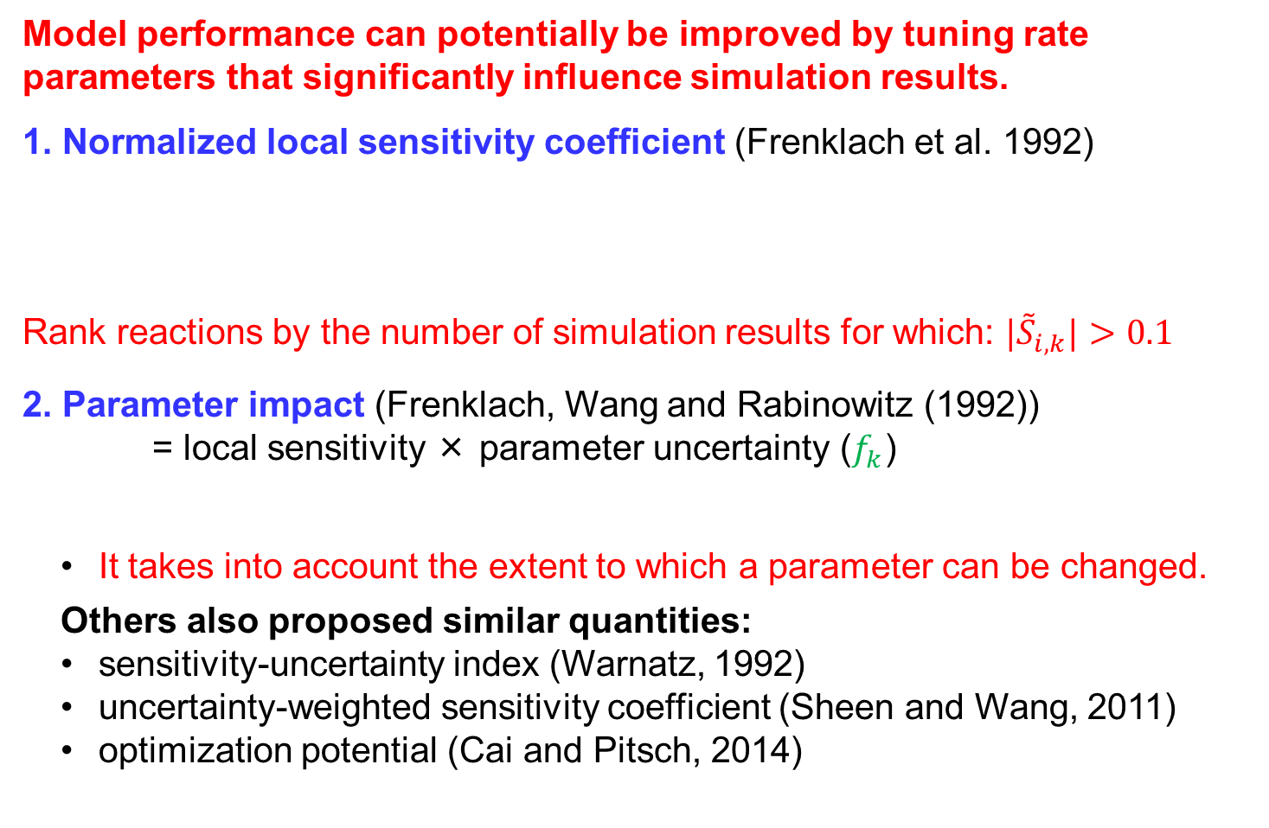

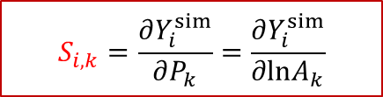
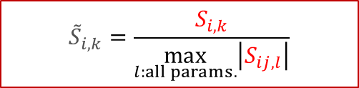
Topic 2: Selecting active parameters for optimization
Model performance can potentially be improved by tuning rate parameters that significantly influence simulation results.
1. Normalized local sensitivity coefficient (Frenklach et al. 1992)
Rank reactions by the number of simulation results for which: ${|\tilde{S}}_{i,k}|>0.1$
2. Parameter impact (Frenklach, Wang and Rabinowitz (1992))
= local sensitivity × parameter uncertainty ($f_{k}$)
  It takes into account the extent to which a parameter can be changed.
  Others also proposed similar quantities:
  sensitivity-uncertainty index (Warnatz, 1992)
  uncertainty-weighted sensitivity coefficient (Sheen and Wang, 2011)
  optimization potential (Cai and Pitsch, 2014)
$$S_{i,k}=\frac{∂Y_{i}^{sim}}{∂P_{k}}=\frac{∂Y_{i}^{sim}}{∂lnA_{k}}$$
$${\tilde{S}}_{i,k}=\frac{S_{i,k}}{\max_{l:all params.}\left|S_{ij,l}\right|}$$
$$I_{ij,k}=S_{ij,k}f_{k} { S}_{ij,k}σ_{k}$$

Slide 18

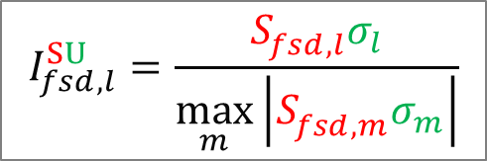



Single global impact measures for parameter ranking
Normalized Sensitivity:
Sensitivity-based impact:
˝S strategy˝
Uncertainty-scaled sensitivity:
$σ_{l}$: std of parameter uncertainty
Uncertainty-scaled impact:
˝SU strategy˝
$$I_{fsd,l}^{S }=\frac{S_{fsd,l}^{ }}{\max_{m}\left|S_{fsd,m}^{ }\right|}$$
$$I_{fsd,l}^{SU}=\frac{S_{fsd,l}^{ }σ_{l}}{\max_{m}\left|S_{fsd,m}^{ }σ_{m}\right|}$$
$$I_{l}^{S}=\sqrt{\frac{1}{N}\sum_{f=1}^{N_{f}}{\sum_{s=1}^{N_{fs}}{\frac{1}{N_{fsd}}\sum_{d=1}^{N_{fsd}}{{I_{fsd,l}^{S }}^{2}}}}}$$
$$I_{l}^{SU}=\sqrt{\frac{1}{N}\sum_{f=1}^{N_{f}}{\sum_{s=1}^{N_{fs}}{\frac{1}{N_{fsd}}\sum_{d=1}^{N_{fsd}}{{I_{fsd,l}^{SU}}^{2}}}}}$$
Normalized with data series size!
They do not provide a meaningful, absolute scale to help decide how many active parameters need to be tuned.

Slide 19
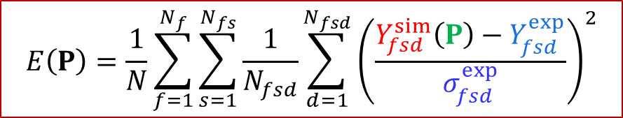
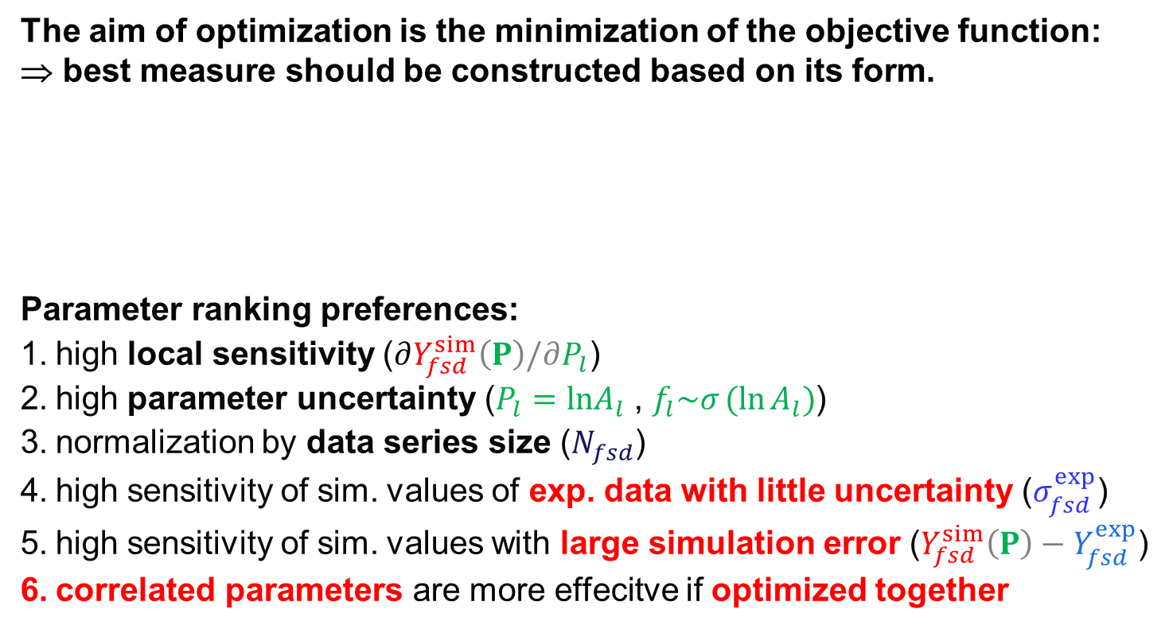
Further important factors to consider
The aim of optimization is the minimization of the objective function:
⇒ best measure should be constructed based on its form.
Parameter ranking preferences:
high local sensitivity ($∂Y_{fsd}^{sim}\left(P\right)/∂P_{l}$)
high parameter uncertainty ($P_{l}=lnA_{l}$ , $f_{l}\sim σ_{ }({\ln{A}}_{l})$)
normalization by data series size ($N_{fsd}$)
high sensitivity of sim. values of exp. data with little uncertainty ($σ_{fsd}^{exp}$)
high sensitivity of sim. values with large simulation error ($Y_{fsd}^{sim}\left(P\right)−Y_{fsd}^{exp}$)
correlated parameters are more effecitve if optimized together
$$E\left(P\right)=\frac{1}{N}\sum_{f=1}^{N_{f}}{\sum_{s=1}^{N_{fs}}{\frac{1}{N_{fsd}}\sum_{d=1}^{N_{fsd}}{{\left(\frac{Y_{fsd}^{sim}\left(P\right)−Y_{fsd}^{exp}}{σ_{fsd}^{exp}}\right)}^{2}}}}$$

Slide 20

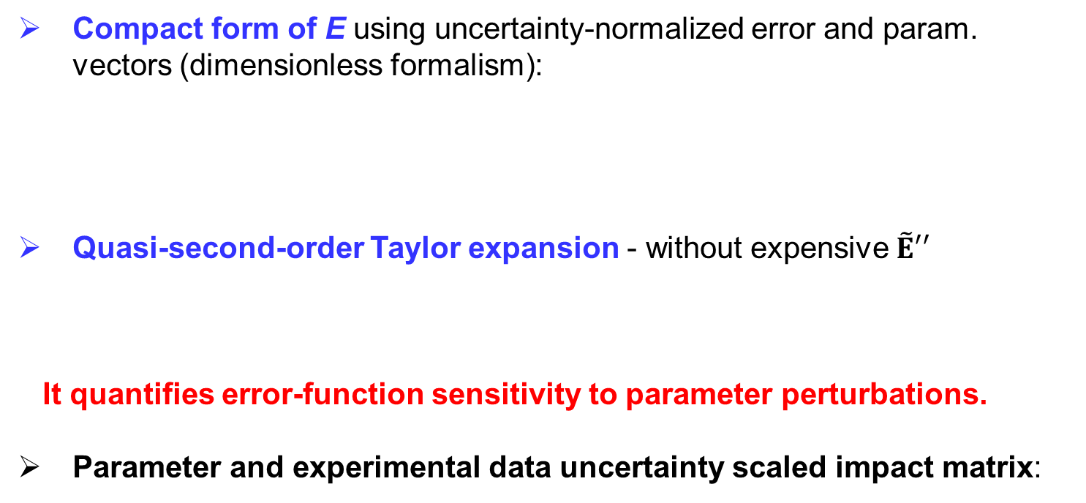
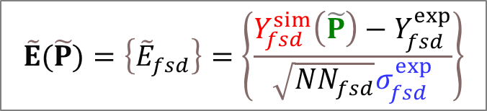
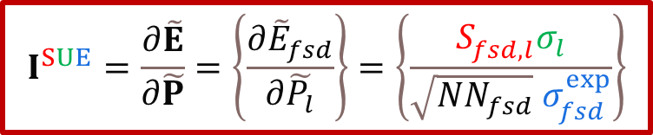

Second-order expansion of the error function
Compact form of E using uncertainty-normalized error and param. vectors (dimensionless formalism):
Quasi-second-order Taylor expansion - without expensive $\tilde{E}′′$
It quantifies error-function sensitivity to parameter perturbations.
Parameter and experimental data uncertainty scaled impact matrix:
$$\tilde{E}(\tilde{P})=\left\{{\tilde{E}}_{fsd}\right\}=\left\{\frac{Y_{fsd}^{sim}\left(\tilde{P}\right)−Y_{fsd}^{exp}}{\sqrt{NN_{fsd}}σ_{fsd}^{exp}}\right\}$$
$$\tilde{P}=\left\{\tilde{P_{l}}\right\}=\left\{\frac{P_{l}}{σ_{l}}\right\}$$
$$E(\tilde{P})={\tilde{E}}^{T}(\tilde{P})\tilde{E}(\tilde{P})$$
$$ΔE≈{(\tilde{E}}^{T}\tilde{E})´∆\tilde{P}+{½∆{\tilde{P}}^{T}(\tilde{E}}^{T}\tilde{E})´´∆\tilde{P}≈2{\tilde{E}}^{T}I^{SUE}∆\tilde{P}+{∆\tilde{P}}^{T}I^{SUE,T}I^{SUE}∆\tilde{P}$$
$$I^{SUE}=\frac{∂\tilde{E}}{∂\tilde{P}}=\left\{\frac{∂{\tilde{E}}_{fsd}}{∂\tilde{P_{l}}}\right\}=\left\{\frac{S_{fsd,l}^{ }σ_{l}}{\sqrt{NN_{fsd}} σ_{fsd}^{exp}}\right\}$$
S for sensitivity
U for parameter uncertainty
E for experimental uncertainty
Notes:
${\tilde{E}}^{T}I^{SUE}$=$I^{SUE,T}{\tilde{E}}^{ }$
Positive semi-definite

Slide 21

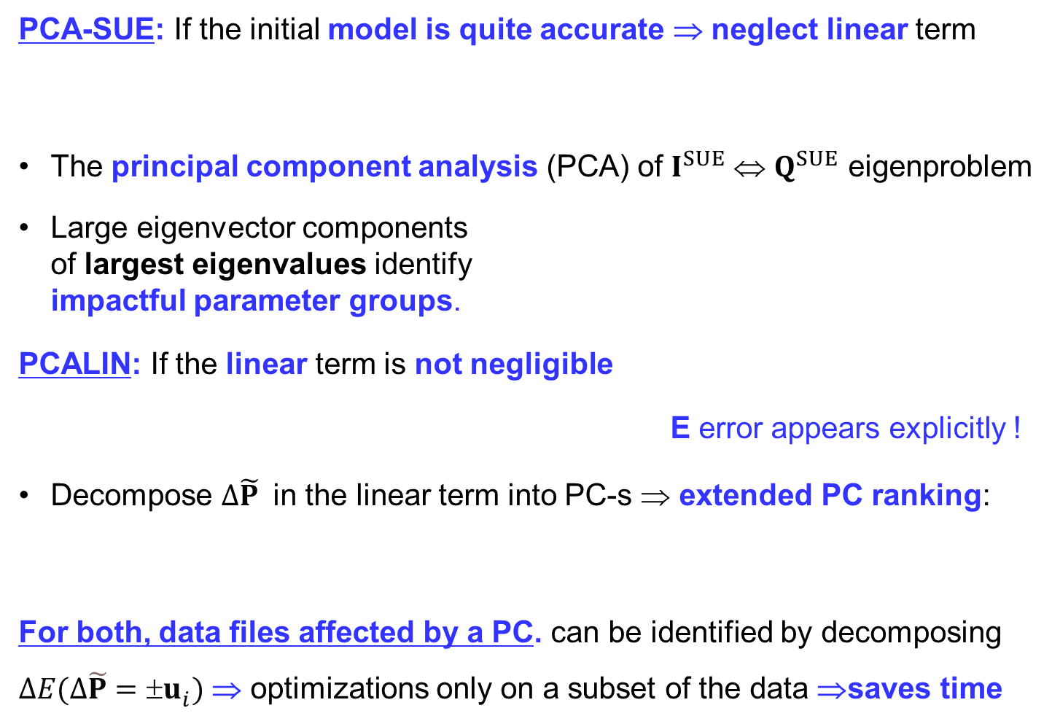

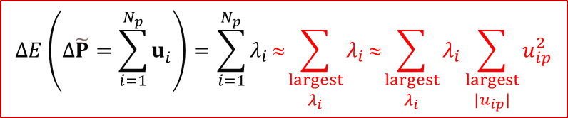

The PCA-SUE and PCALIN methods
PCA-SUE: If the initial model is quite accurate ⇒ neglect linear term
The principal component analysis (PCA) of $I^{SUE}$⇔ $Q^{SUE}$ eigenproblem
Large eigenvector components
of largest eigenvalues identify
impactful parameter groups.
PCALIN: If the linear term is not negligible
E error appears explicitly !
Decompose $∆\tilde{P}$ in the linear term into PC-s ⇒ extended PC ranking:
For both, data files affected by a PC. can be identified by decomposing $ΔE(∆\tilde{P}=±u_{i}^{ })$ ⇒ optimizations only on a subset of the data ⇒saves time
$$ΔE(∆\tilde{P})≈ ∆{\tilde{P}}^{T}I^{SUE,T}I^{SUE}∆\tilde{P}$$
$Q^{SUE}$=$I^{SUE,T}I^{SUE}$
$$Q^{SUE}u_{i}^{ }=λ_{i}u_{i}^{ }$$
$$ΔE\left(Δ\tilde{P}=\sum_{i=1}^{N_{p}}{u_{i}^{ }}\right)=\sum_{i=1}^{N_{p}}{λ_{i}}≈\sum_{\begin{aligned}largest \\ λ_{i}\end{aligned}}^{ }{λ_{i}}≈\sum_{\begin{aligned}largest \\ λ_{i}\end{aligned}}^{ }{λ_{i}}\sum_{\begin{aligned}largest \\ {|u}_{ip}|\end{aligned}}^{ }{u_{ip}^{2}}$$
$$ΔE≈2{\tilde{E}}^{T}I^{SUE}∆\tilde{P}+∆{\tilde{P}}^{T}I^{SUE,T}I^{SUE}∆\tilde{P}$$
$$ΔE(∆\tilde{P}=±u_{i}^{ })≈±2{\tilde{E}}^{T}I^{SUE}u_{i}+λ_{i}≤2\left|{\tilde{E}}^{T}I^{SUE}u_{i}\right|+λ_{i}$$

Slide 22
Test system: methanol/NO_{x}
M. Kovács, M. Papp, I.Gy. Zsély, T.Turányi, Int. J. Chem. Kinet. 53 (2021) 884–900
Main sources of uncertainty in recent methanol/NOx combustion models.
Large collection of experimental concentrations data was compiled:
17 methanol/NO_{x} reaction mechanisms was compared ⇒
Glarborg-2018 mech. was selected (Glarborg et al., Prog. Energy Combust. Sci., 2018) and was updated with our previously optimized models from:
  H₂/CO mech.: ELTE-2016 (Varga et al., Int. J. Chem. Kinet. 48 (2016) 407–422)
  MeOH mech.: ELTE-2017 (Olm et al., Combust. Flame. 186 (2017) 45–64)
  H₂/NO_{x} mech: ELTE-2020 (Kovács et al., Fuel. 264 (2020) 116720)
The sensitivity and uncertainty analyses of rate coefficients were carried out.
 | Files | Series | Data | T / K | p / atm | φ
Jet stirred reactor (JSR) | 13 | 72 | 765 | 640–1870 | 0.92–10.0 | 0.30–1.34
Tubular flow rector (TFR) | 55 | 160 | 1648 | 298–1420 | 0.99–1.40 | 0.01–13.5
Shock tube (ST) | 6 | 11 | 139 | 1142–1502 | 0.46–0.66 | 0.46–2.00
Total | 74 | 243 | 2552 | 298–1870 | 0.46–10.0 | 0.01–13.5

Slide 23
Reaction rankings for S and SU strategies
Based on sensitivity analysis of 576 A-parameters:
# | S | SU
1 | CH₃OH + OH = CH₃O + H₂O | CH₃OH + NO₂ = HONO + CH₂OH
2 | CH₃OH + OH = CH₂OH + H₂O | CH₃OH + OH = CH₂OH + H₂O
3 | H + O₂ = O + OH | CH₃OH + OH = CH₃O + H₂O
4 | CO + OH = CO₂ + H | HCO + O₂ = CO + HO₂
5 | HO₂ + OH = H₂O + O₂ | HCO + NO₂ = NO + CO₂ + H
6 | HCO + O₂ = CO + HO₂ | CH₂O + NO₂ = HONO + HCO
7 | NO + HO₂ = NO₂ + OH | CH₃OH + O₂ = CH₂OH + HO₂
8 | HCO + M = H + CO + M ^{LP} | NO₂ + HO₂ = HNO₂ + O₂
9 | CH₂O + OH = HCO + H₂O | CH₂O + OH = HCO + H₂O
10 | H + O₂ + M = HO₂ + M ^{LP} | HCO + M = H + CO + M ^{LP}
11 | NO₂ + H = NO + OH | CH₂OH + M = CH₂O + H + M
12 | CH₃OH + NO₂ = HONO + CH₂OH | HNO + O₂ = HO₂ + NO
13 | NO + OH + M = HONO + M ^{LP} | CH₂OH + NO = HNCO + H₂O
14 | HCO + NO₂ = NO + CO₂ + H | CH₂O + HO₂ = HCO + H₂O₂
15 | CH₃OH + HO₂ = CH₂OH + H₂O₂ | HO₂ + OH = H₂O + O₂
16 | CH₂O + NO₂ = HONO + HCO | NO + O + M = NO₂ + M ^{LP}
17 | CH₃OH + O₂ = CH₂OH + HO₂ | HO₂ + HO₂ = H₂O₂ + O₂ ^{DUP1}
18 | CH₃OH + H = CH₂OH + H₂ | CH₃OH + HO₂ = CH₂OH + H₂O₂
19 | CH₂OH + O₂ = CH₂O + HO₂ ^{DUP1} | HNO + H = NO + H₂
20 | CH₂OH + NO = HNCO + H₂O | CH₂OH + H = CH₃ + OH
methanol/NOx
syngas/NOx
hydrogen/NOx
methanol
syngas
hydrogen
INCREASING
UNCERTAINTY
The SU strategy
ranks previously optimized, highly constrained reactions
low (H₂, syngas), and
ranks highly uncertain methanol/NOx reactions high.

Slide 24


Reaction rankings for PCA based strategies
N_{reac}=576,
N_{files}=74, PCA>90%
# | PCA-SU | PCA-SUE | PCALIN (SUE)
1 | CH₃OH + NO₂ = HONO + CH₂OH | CH₃OH + NO₂ = HONO + CH₂OH | CH₃OH + OH = CH₂OH + H₂O
2 | CH₃OH + OH = CH₃O + H₂O | CH₂O + NO₂ = HONO + HCO | HCO + O₂ = CO + HO₂
3 | HCO + O₂ = CO + HO₂ | HCO + NO₂ = NO + CO₂ + H | CH₃OH + NO₂ = HONO + CH₂OH
4 | CH₂O + NO₂ = HONO + HCO | CH₃OH + OH = CH₃O + H₂O | HCO + NO₂ = NO + CO₂ + H
5 | HCO + M = H + CO + M ^{LP} | HCO + O₂ = CO + HO₂ | HCO + M = H + CO + M ^{LP}
6 | HCO + NO₂ = NO + CO₂ + H | HCO + M = H + CO + M ^{LP} | CH₃OH + OH = CH₃O + H₂O
7 | CH₃OH + OH = CH₂OH + H₂O | CH₂O + NO₂ = HNO₂ + HCO | NO₂ + HO₂ = HNO₂ + O₂
8 | NO₂ + HO₂ = HNO₂ + O₂ | CH₃OH + OH = CH₂OH + H₂O | CH₂O + NO₂ = HONO + HCO
9 | HO₂ + OH = H₂O + O₂ | CH₂O + OH = HCO + H₂O | HNO + O₂ = HO₂ + NO
10 | CH₂O + HO₂ = HCO + H₂O₂ | NO + OH + M = HONO + M ^{LP} | CH₂OH + NO = HNCO + H₂O
11 | CH₃OH + O₂ = CH₂OH + HO₂ | CH₃OH + O₂ = CH₂OH + HO₂ | CH₂O + NO₂ = HNO₂ + HCO
12 | CH₂OH + M = CH₂O + H + M | CH₂OH + NO = HNCO + H₂O | HNO + NO₂ = HONO + NO
13 | NO + HO₂ = NO₂ + OH | CH₃O + M = CH₂O + H + M | CH₂OH + HNO = NO + CH₃OH
14 | H + O₂ + M = HO₂ + M ^{LP} | NO + HO₂ = NO₂ + OH | CH₂OH + NO₂ = HONO + CH₂O
15 | NO + OH + M = HONO + M ^{LP} | HNO + O₂ = HO₂ + NO | CH₂O + HO₂ = HCO + H₂O₂
16 | CH₂O + OH = HCO + H₂O | CH₂OH + M = CH₂O + H + M | HO₂ + HO₂ = H₂O₂ + O₂ ^{DUP1}
17 | HNO + O₂ = HO₂ + NO | HO₂ + OH = H₂O + O₂ | CH₃OH + HO₂ = CH₂OH + H₂O₂
18 | HNO + H = NO + H₂ | HNO + NO₂ = HONO + NO | CH₂O + OH = HCO + H₂O
19 | NO + O + M = NO₂ + M ^{LP} | CH₂OH + HNO = NO + CH₃OH | H₂O₂ + OH = H₂O + HO₂ ^{DUP1}
20 | NO + H + M = HNO + M ^{LP} | CH₂OH + NO₂ = HONO + CH₂O | H₂O₂ + OH = H₂O + HO₂ ^{DUP2}
21 | HNO + OH = NO + H₂O | NO₂ + HO₂ = HNO₂ + O₂ | NO₂ + HO₂ = HONO + O₂
22 | HNO + NO₂ = HONO + NO | CH₃OH + H = CH₂OH + H₂ | HO₂ + HO₂ = H₂O₂ + O₂ ^{DUP2}
23 | CH₂OH + NO = HNCO + H₂O | HNO + H = NO + H₂
PC | PCA- SU |  | PCA- SUE |  | PCA LIN
PC | N_{p} | N_{f} | N_{p} | N_{f} | N_{p} | N_{f}
1 | 10 | 58 | 7 | 40 | 10 | 36
1-2 | 15 | 61 | 9 | 45 | 11 | 51
1-3 | 23 | 69 | 14 | 55 | 14 | 53
1-4 |  |  | 18 | 57 | 22 | 54
1-5 |  |  | 23 | 60
methanol/NOx
syngas/NOx
hydrogen/NOx
methanol
syngas
hydrogen
INCREASING
UNCERTAINTY
Ratio of terms:
lin:quad = 3:5
$$Q^{SU}=I^{SU,T}I^{SU}$$
$$Q^{SUE}=I^{SUE,T}I^{SUE}$$
No exp. uncertainty (E)

Slide 25
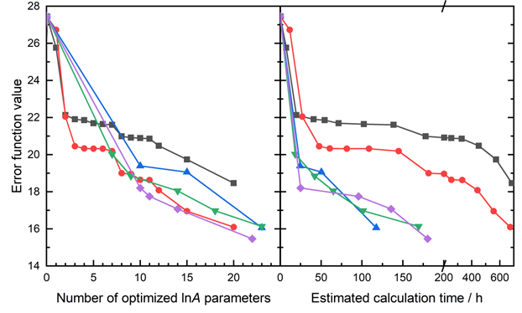
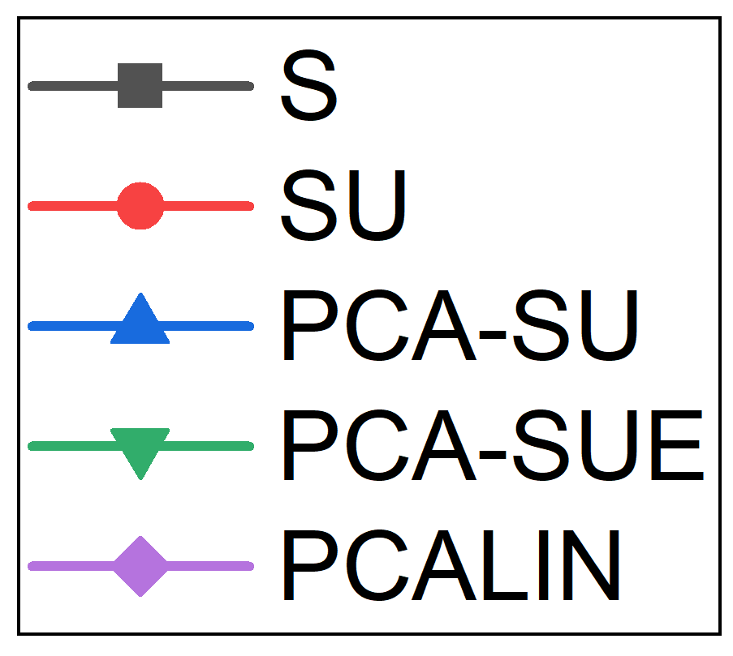
Optimization of the ’A’ pre-exponential factors
SU gives more accurate models than S strategy, but both show stagnations.
PCA-based strategies reduce error steadily & faster (par.groups+data subset).
Best model at same number of opt. params.: PCALIN > PCA-SUE > PCA-SU
M. Kovács, M. Papp, T. Turányi, T. Nagy, Proc. Combust. Inst. 39 (2023) 5259-5267.

Slide 26
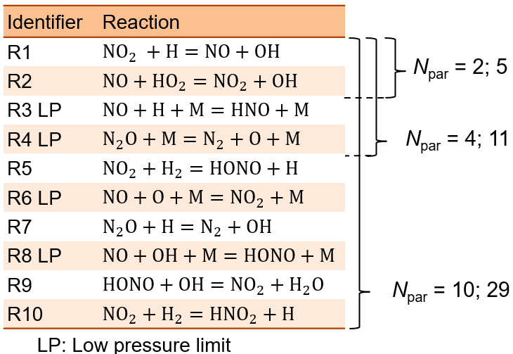

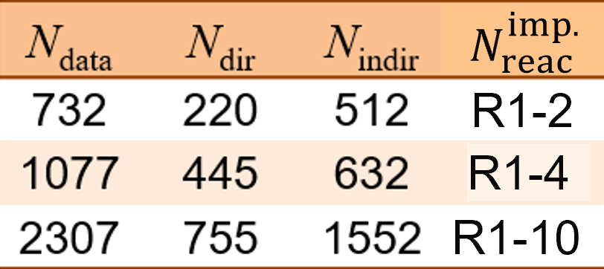
Topic 3: Numerical methods for optimization
Benchmark study on ELTE-2016 syngas + Glarborg-2018 nitrogen mechs.
Goitom, S. K., Papp, M., Kovács, M., Nagy, T., Zsély, I. Gy., Turányi, T., & Pál, L. (2022). Combust. Theory Model., 26(6), 1071–1097.
A and AnE optimization
Three subsets of
the data collection
Shock tube IDTs
Flow reactor concs.
Both Optima (Matlab) and
Optima++ (C++) was
used the study.
Important reactions
Methods were allowed to search within the uncertainty range ($\log_{10}k(T)±f(T)$)
$$f(T\text{;} \text{Σ}\text{p})=\frac{3}{\ln{10}}\sqrt{σ_{α}^{2}+σ_{n}^{2}\ln^{2}{T}+σ_{ε}^{2}T^{−2}+2r_{αn}σ_{α}σ_{n}\ln{T}−2r_{αε}σ_{α}σ_{ε}T^{−1}−2r_{nε}σ_{n}σ_{ε}T^{−1}\ln{T}}$$

Slide 27
Local optimization methods
Abbreviation | Full name | Properties
Simplex [7] | Nelder-Mead simplex method | nonlinear, unconstrained (implementation: fminsearch)
Pattern search [8] | Pattern search | derivative-free, non-smooth constrained or unconstrained
Interior-point [9] | Constrained optimization method, interior-point variant | nonlinear, constrained (implementation: fmincon)
Quasi-Newton [10] | Unconstrained optimization method, quasi-Newton variant | unconstrained (implementation: fminunc)
BOBYQA1 [11] | Bound Optimization BY Quadratic Approximation | derivative-free, bound-constrained (implementation: from NLopt)
BOBYQA2 [11] | Bound Optimization BY Quadratic Approximation | derivative-free, bound-constrained (implementation: from Dlib C++)
NEWUOA [12] | New Unconstrained Optimization with Quadratic Approximation | derivative-free, unconstrained (implementation: from NLopt)
The error function is a hypersurface over the space of active parameters.
Local methods cannot jump between wells, thus very sensitive to the starting parameter values.

Slide 28
Global optimization methods
Abbreviation | Full name | Properties
FOCTOPUS Distribution: N: normal U: uniform | Focusing Robust Optimization with Uncertainty-based Sampling | with a gradually focusing sampling distribution around the instantaneous best parameter set
GA [3] | Genetic algorithm | heuristic, population-based, mimics the natural selection
SA [4] | Simulated annealing | attain a virtual lowest free energy state
PSO [5] | Particle swarm optimization | stochastic, population based
CMA-ES [6] | Covariance Matrix Adaptation Evolutionary Strategy | state-of-the-art evolutionary
They try to explore the entire parameter space using stochastic algorithms to probe the unknown “terrain”.
By adjusting the settings (N_{samples}), they may achieve better results. However, reaching the global optimum is not guaranteed in high-dimensional spaces.

Slide 29
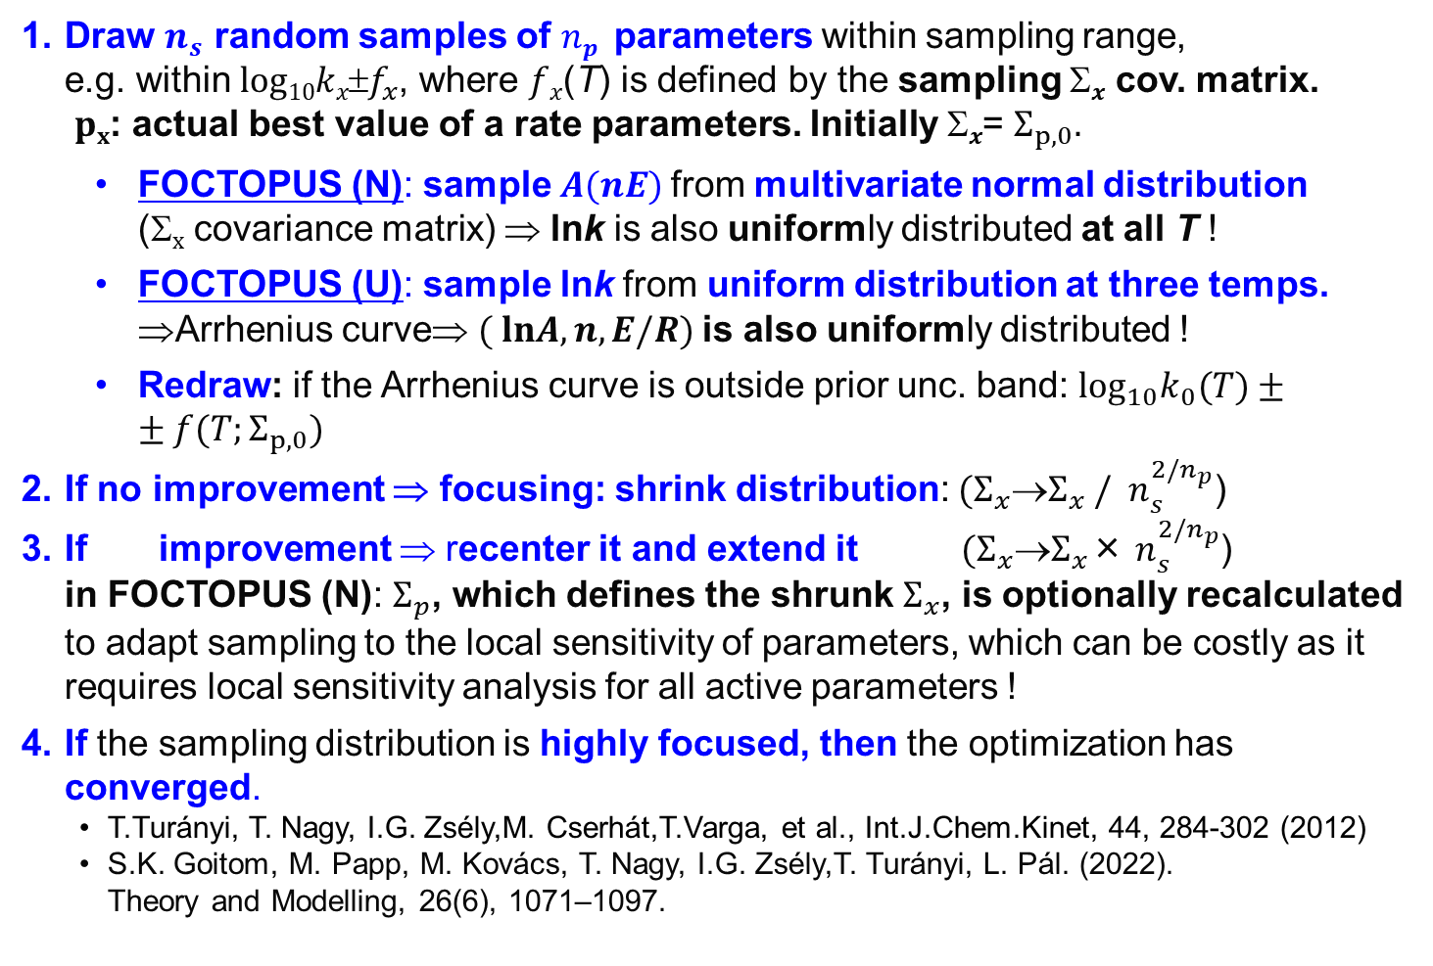
FOCTOPUS method
FOCusing RobusT OPtimization with Uncertainty-based Sampling
Draw $n_{s}$ random samples of $np$ parameters within sampling range,
e.g. within $log10kxf_{x}$, where $fx$(T) is defined by the sampling $x$ cov. matrix.
$px$: actual best value of a rate parameters. Initially $x$= $Σ_{p,0}.$
    FOCTOPUS (N): sample $A(nE)$from multivariate normal distribution
    (Σ_{x} covariance matrix) ⇒ lnk is also uniformly distributed at all T !
    FOCTOPUS (U): sample lnk from uniform distribution at three temps. ⇒Arrhenius curve⇒ $( lnA, n, E/R)$is also uniformly distributed !
    Redraw: if the Arrhenius curve is outside prior unc. band: $\log_{10}k_{0}(T)±±f(T;Σ_{p,0})$
If no improvement ⇒ focusing: shrink distribution: $(Σ_{x}Σ_{x} /{ n}_{s}^{2/n_{p}}$)
If improvement ⇒ recenter it and extend it $(Σ_{x}Σ_{x}$× $n_{s}^{2/n_{p}}$)
in FOCTOPUS (N): $Σ_{p}$, which defines the shrunk $Σ_{x}$, is optionally recalculated to adapt sampling to the local sensitivity of parameters, which can be costly as it requires local sensitivity analysis for all active parameters !
If the sampling distribution is highly focused, then the optimization has converged.
T.Turányi, T. Nagy, I.G. Zsély,M. Cserhát,T.Varga, et al., Int.J.Chem.Kinet, 44, 284-302 (2012)
S.K. Goitom, M. Papp, M. Kovács, T. Nagy, I.G. Zsély,T. Turányi, L. Pál. (2022).
Theory and Modelling, 26(6), 1071–1097.

Slide 30
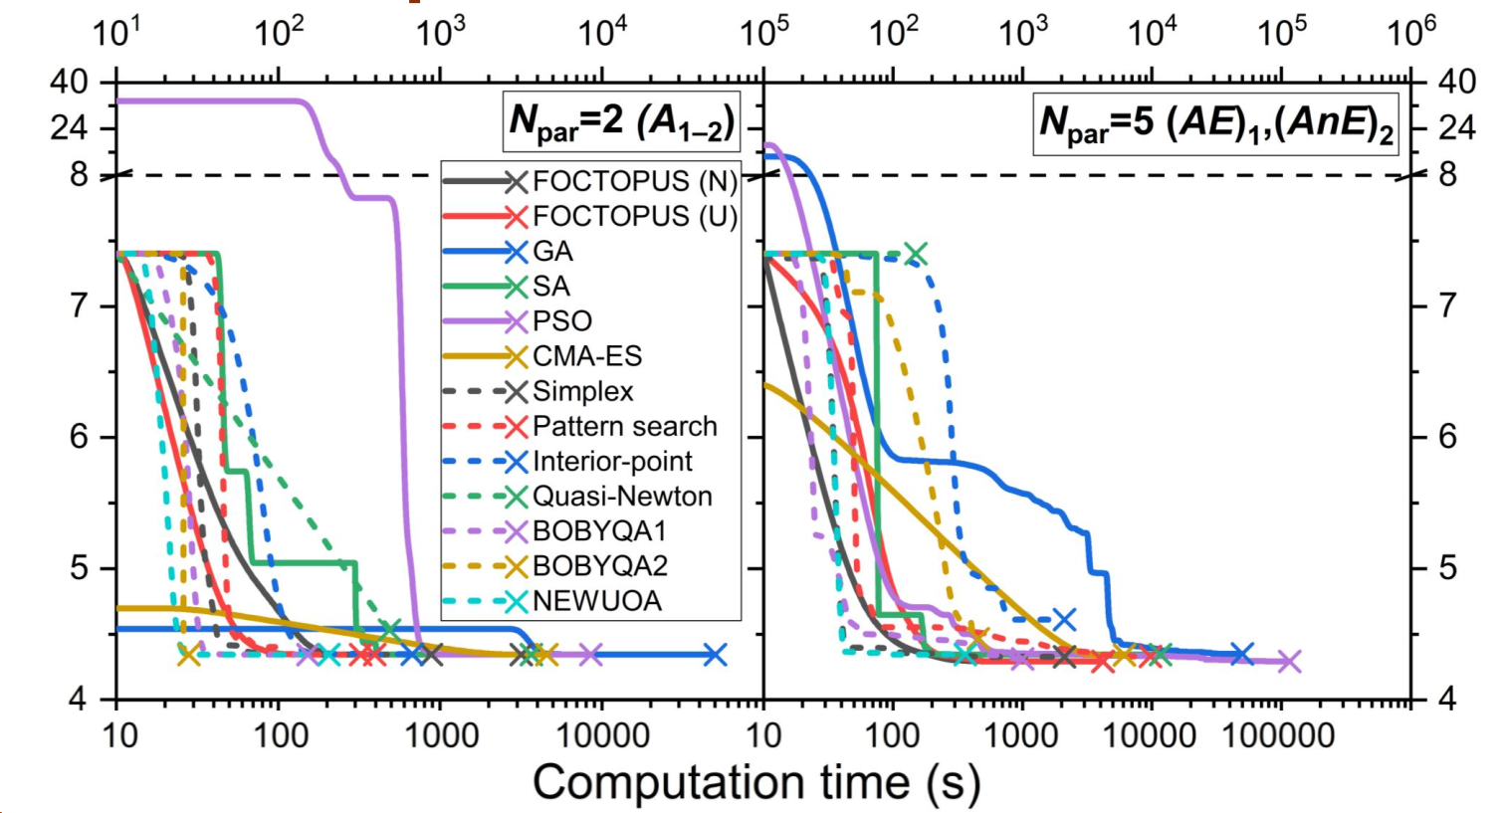
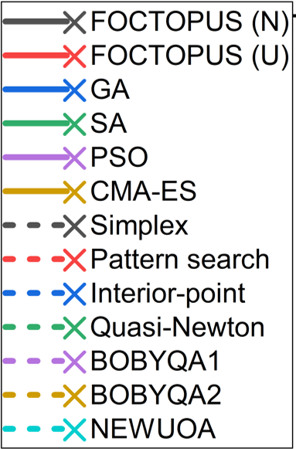
Results for test case 1 (N_{data}=732, 2 reactions)
Most methods achieved equally good results.
For this simple case, optimizing all Arrhenius parameters offered little advantage over optimizing only A, which converged usually 2-10 times faster.

Slide 31
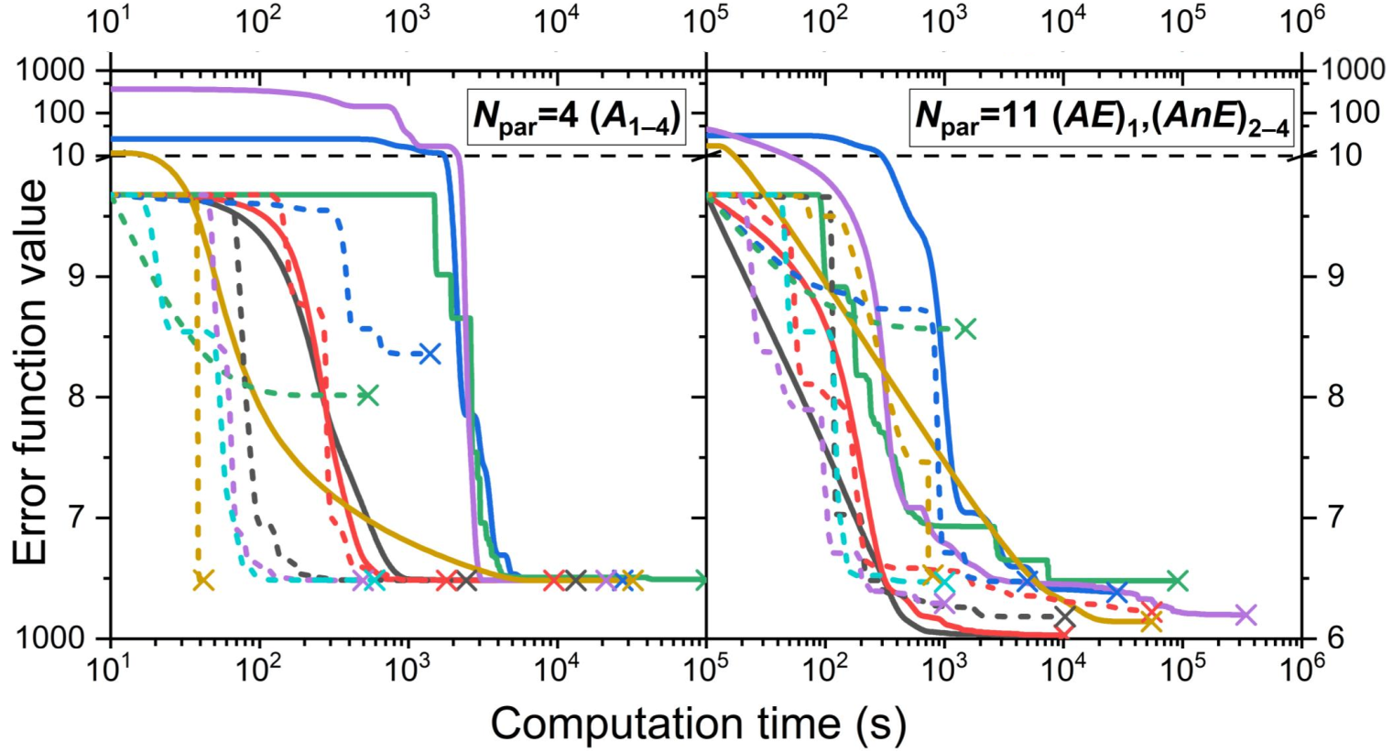
Results for test case 2 (N_{data}=1077, 4 reactions)
Optimizing all Arrhenius parameters offered moderate advantage over optimizing only A.
FOCTOPUS gave the best AnE-tuned models
and was the fastest global method.

Slide 32
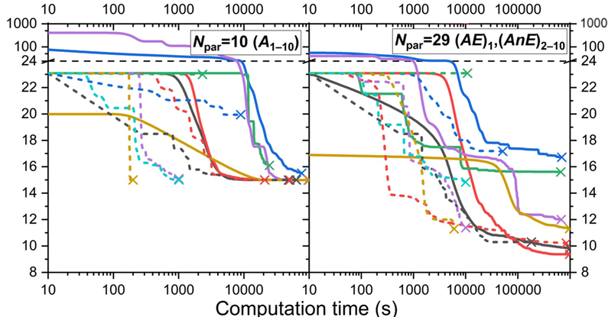
Results for test case 3 (N_{data}=1552, 10 reactions)
Optimizing all Arrhenius parameters offered significant advantage over optimizing only A.
FOCTOPUS gave the best AnE-tuned models.

Slide 33
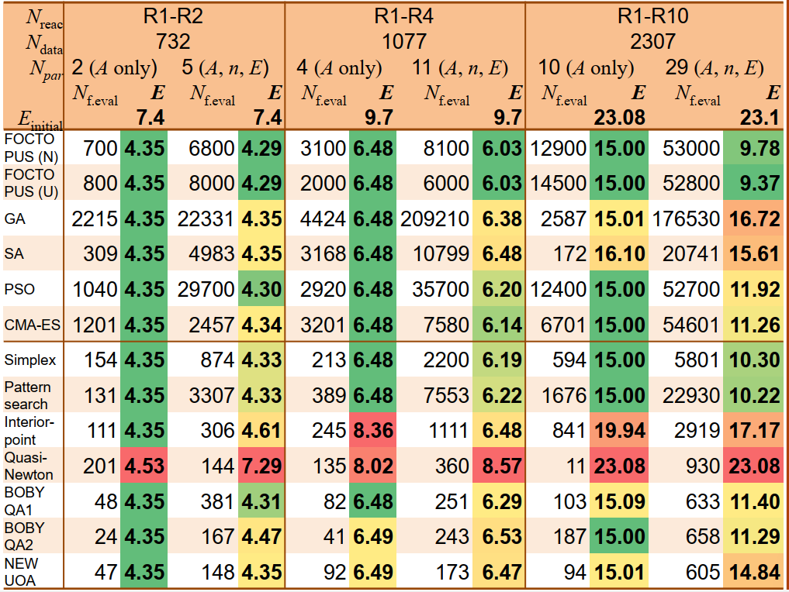
Final errors and computation time
FOCTOPUS gave
the lowest error
in all cases.
most robust
Simplex was the most robust local method.
BOBYQA2 was the
most efficient local method.
They are available in Optima++.
Many global minima for many parameter problems ⇒ use global methods !
In our optimization studies with used FOCTOPUS.
Earlier studies with smaller problems (datasets, mech., active params), we used FOCTOPUS (N) with covariance matrix update ( ~ sens. anal. for active pars.).
For larger problems (recently), we use the more efficient FOCTOPUS (U).

Slide 34
Example 2: N-pentanol chemistry in NUIGMech
Validated, reliable results for a wide array of fuels:
H₂, H₂/CO (syngas), C₁-C₅ saturated and unsaturated hydrocarbons.
C₁-C₄ alcohols, dimethyl ether, C₁-C₂ aldehydes.
Addition of n-pentanol chemistry was recently added by Curran, Pitz and coworkers.
Validated for multiple fuels and blend.
Was built hierarchically
⇒ rate coefficients in the core chemistry are highly constrained
Size: ~ 2800 species, ~ 9500 rever. and 2000 irrev. reactions.
Simulations take a very long time.
Hard to optimize when a new fuel is added.
Chatterjee, T.; Saggese, C.; Dong, S.; Patel, V.; Lockwood, K.B.; Curran, H.J.; Labbe, N.; Wagnon, S.W.; Pitz, W.J.: Experimental and kinetic modeling study of the low temperateure and high-pressure combustion chemistry of straight chain pentanol isomers: 1-, 2- and 3-Pentanol. Submitted to Proc. Combust. Inst.

Slide 35
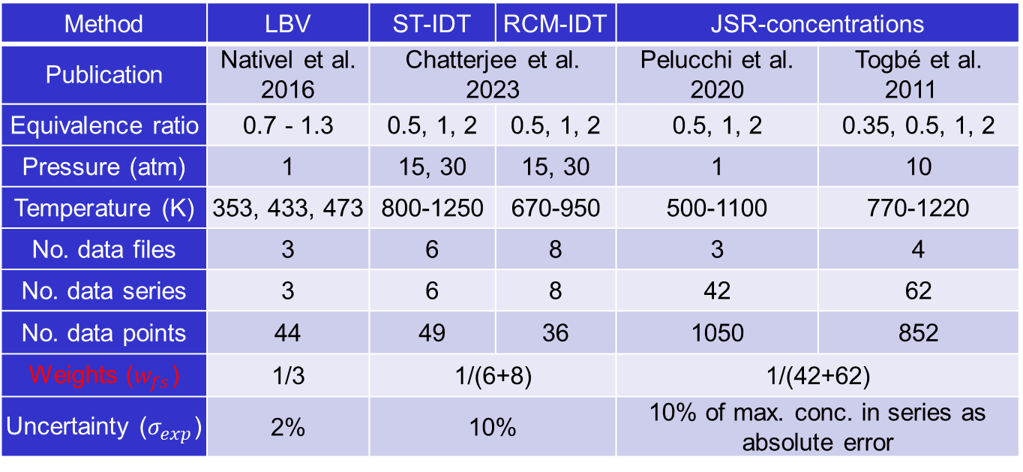
Example 2: Experimental data for n-pentanol
Method | LBV | ST-IDT | RCM-IDT | JSR-concentrations
Publication | Nativel et al. 2016 | Chatterjee et al. 2023 |  | Pelucchi et al. 2020 | Togbé et al. 2011
Equivalence ratio | 0.7 - 1.3 | 0.5, 1, 2 | 0.5, 1, 2 | 0.5, 1, 2 | 0.35, 0.5, 1, 2
Pressure (atm) | 1 | 15, 30 | 15, 30 | 1 | 10
Temperature (K) | 353, 433, 473 | 800-1250 | 670-950 | 500-1100 | 770-1220
No. data files | 3 | 6 | 8 | 3 | 4
No. data series | 3 | 6 | 8 | 42 | 62
No. data points | 44 | 49 | 36 | 1050 | 852
Weights ($w_{fs}$) | 1/3 | 1/(6+8) |  | 1/(42+62)
Uncertainty ($σ_{exp}^{ }$) | 2% | 10% |  | 10% of max. conc. in series as absolute error
LBV: IDT: JSR = 3:14:104 ⇒ unbalanced data collection ⇒ reweighting
OpenSMOKE++ for 0D reactors, and Zero-RK for flames.
Direct optimization are extremely slow even for 0D reactions.
Flame simulations have convergence issues with the full model.

Slide 36
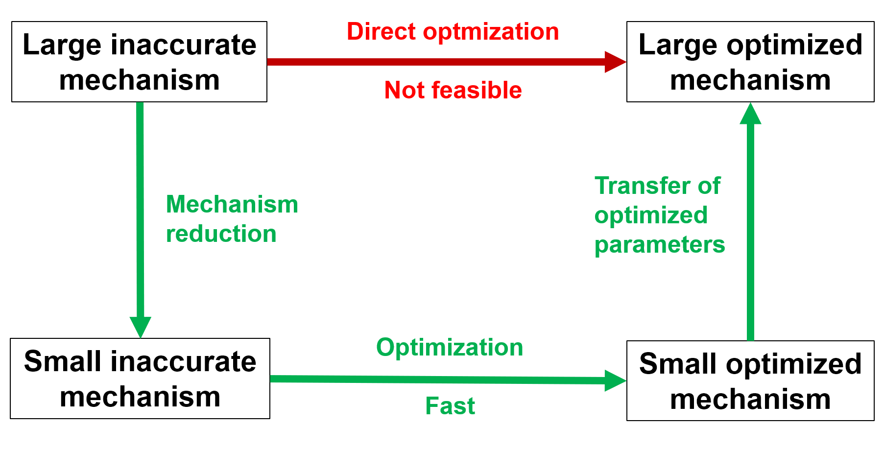
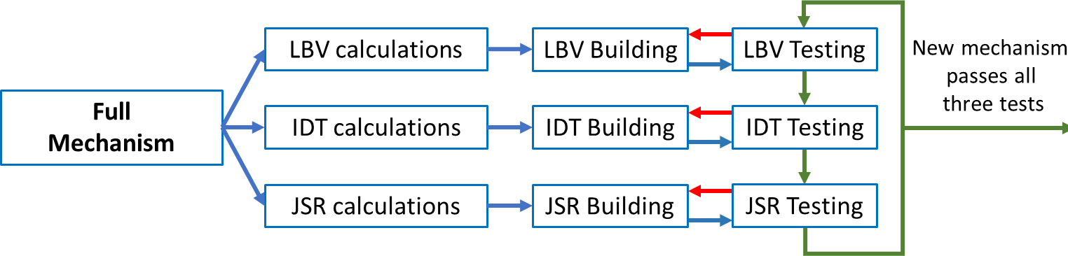

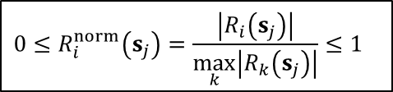
Example 2: Reduction-assisted parameter optimization-based model development (RAPOD)
RAPOD
Reactions were ranked according to the maximum of normalized absolute reaction rates for states (s_{j}) taken from simulations, separately for LBV, IDT, JSR concs.
$$0≤R_{i}^{norm}\left(s_{j}\right)=\frac{\left|R_{i}\left(s_{j}\right)\right|}{\max_{k}\left|R_{k}\left(s_{j}\right)\right|}≤1$$
ITERATIVE
REDUCTION
$$R_{i}^{norm}=\max_{j}{R_{i}^{norm}\left(s_{j}\right)}$$
Reduction:2831s/11680r→322s/2096r, 40×speedup in 0D,no convergence issues in flames!
L.Horváth, S.Dong,C.Saggese,M.Papp,H.J.Curran,W.J.Pitz,T.Turányi,T.Nagy, ECM 2023, Rouen.
Other published application to ethylene mechanism in Aramco 2.0 mechanism:
B Su, T Nagy, M Papp, T Turányi: Comb. Flame 273 (113976)

Slide 37
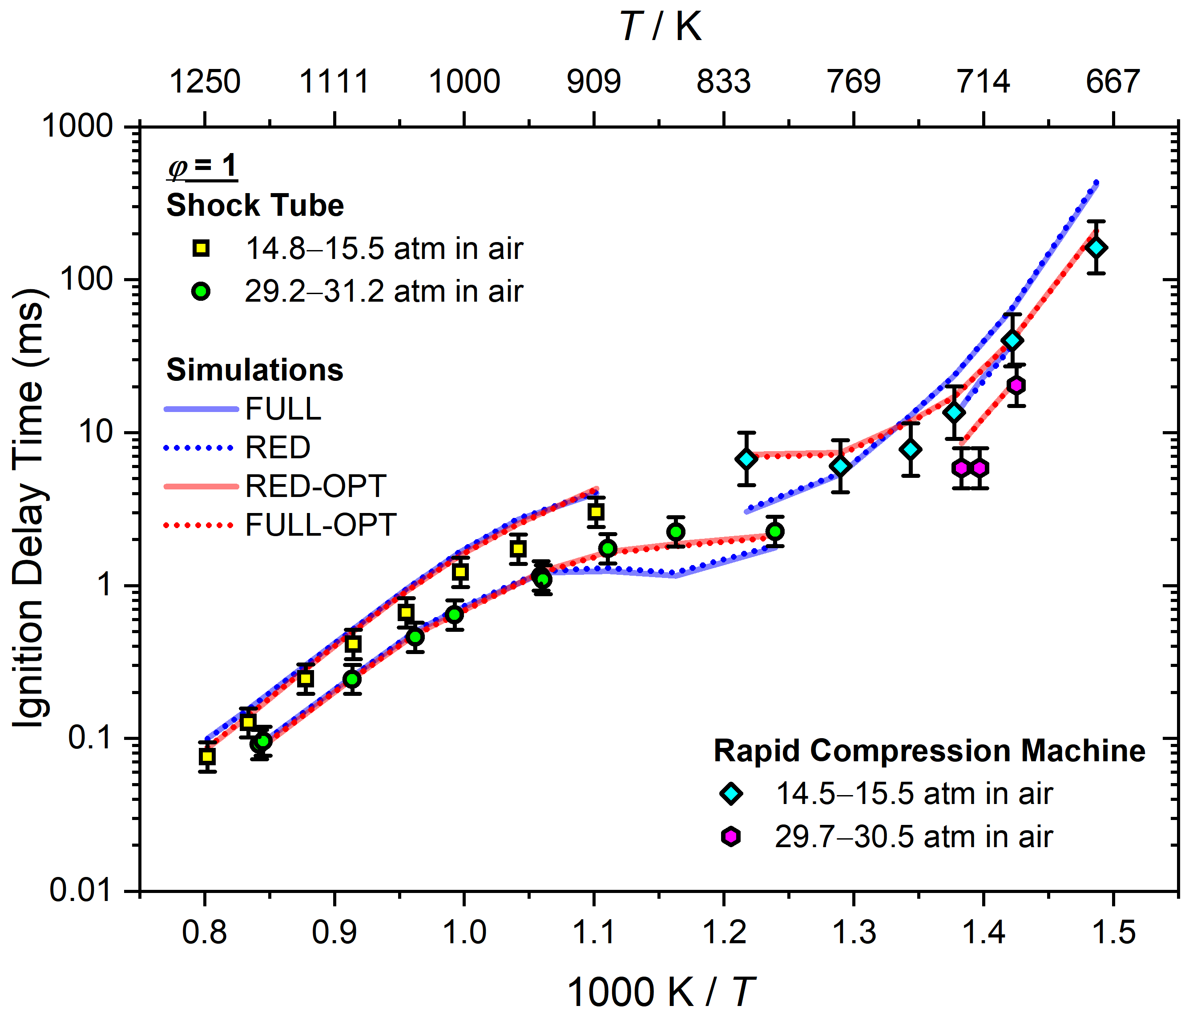
Example 2: Reduction-assisted parameter optimization-based model development (RAPOD)

Slide 38
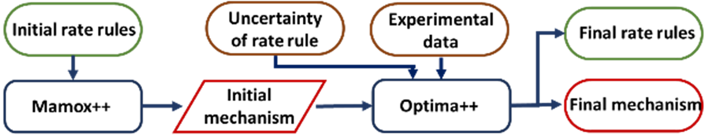
Example 3: Rate rule optimization for large alkanes
Mechs. of large hydrocarbon fuels (from C5) contain thousands of species and reactions.
Reaction class: same type of reactions
Rate rule: reactions within a reaction class in similar chemical environments have approximately same rate coefficients – good approximation for C5 species and above.
Mechanisms of three pentane isomers were generated based on 185 rate rules and merged with NUIGMech 1.3 C0-C4 core mechanisms 3000 species + 4635 reactions
The number of rate rules are much less than that of reactions, which largely simplifies the optimization problem.
  P Wang, S Brunialti, M Papp, SM Sarathy,T Turanyi, HJ Curran, T. Nagy
  Proceedings of the Combustion Institute, 40(1-4), 105408. (2024)

Slide 39
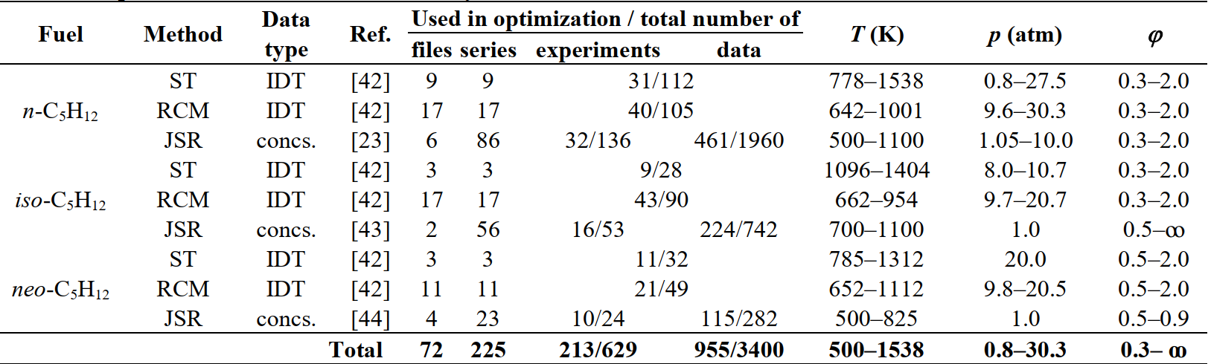
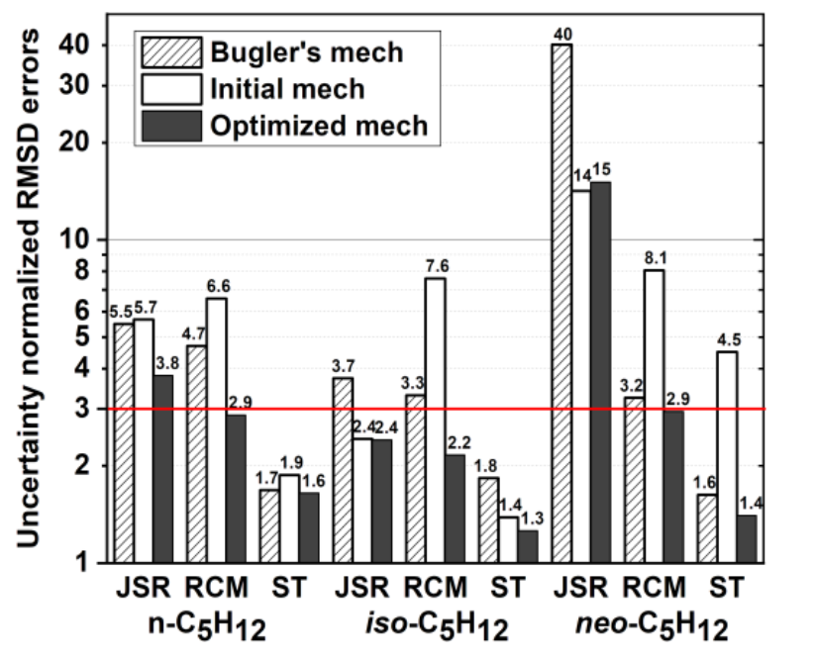
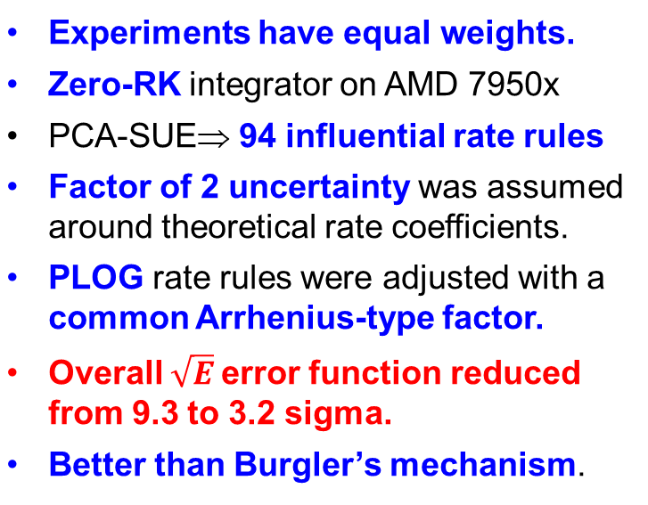
Example 3: Experimental data and optimization
Experiments have equal weights. Zero-RK integrator on AMD 7950x PCA-SUE⇒ 94 influential rate rules Factor of 2 uncertainty was assumed around theoretical rate coefficients. PLOG rate rules were adjusted with a common Arrhenius-type factor. Overall $\sqrt{E}$error function reduced from 9.3 to 3.2 sigma. Better than Burgler’s mechanism.
log error scale !!

Slide 40
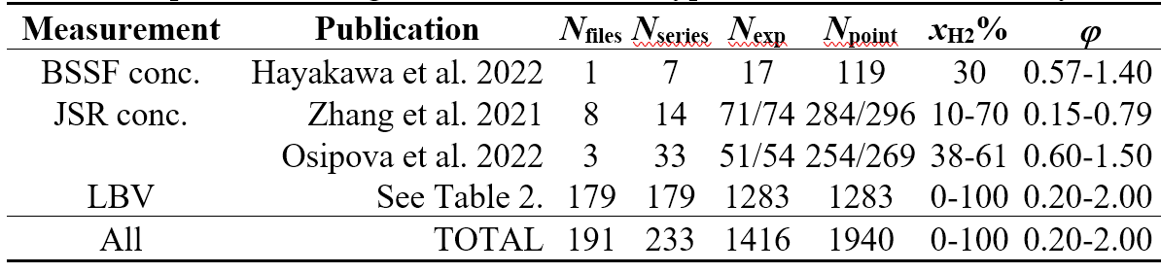
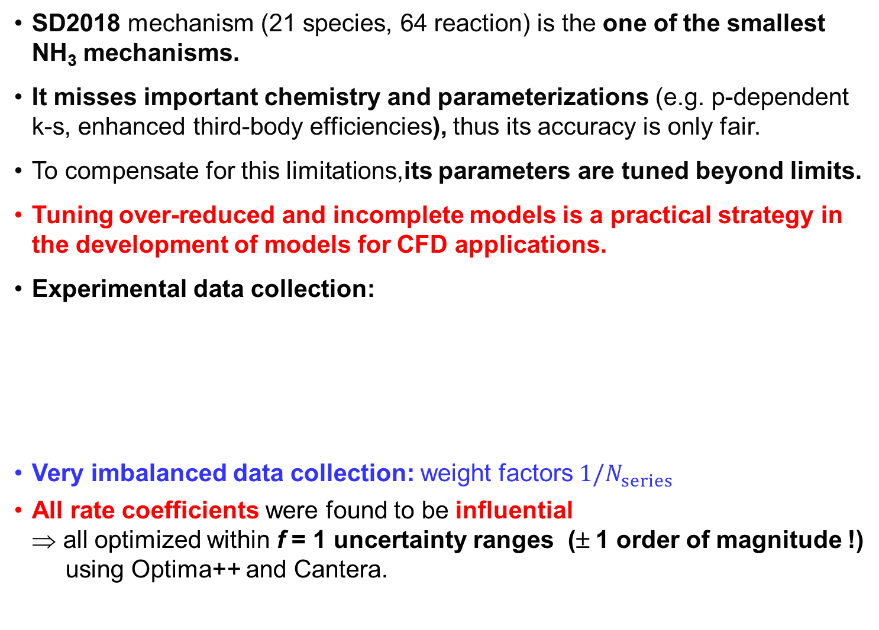
Example 4: San Diego mechanism for NH₃/H₂ flames
SD2018 mechanism (21 species, 64 reaction) is the one of the smallest NH₃ mechanisms.
It misses important chemistry and parameterizations (e.g. p-dependent k-s, enhanced third-body efficiencies), thus its accuracy is only fair.
To compensate for this limitations,its parameters are tuned beyond limits.
Tuning over-reduced and incomplete models is a practical strategy in the development of models for CFD applications.
Experimental data collection:
Very imbalanced data collection: weight factors $1/N_{series}$
All rate coefficients were found to be influential
⇒ all optimized within f = 1 uncertainty ranges (± 1 order of magnitude !)
using Optima++ and Cantera.

Slide 41
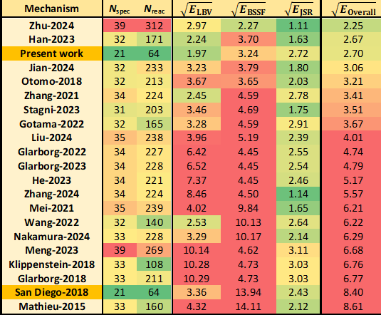
Example 4: San Diego mechanism for NH₃/H₂ flames
Highly improved
for LBV and BSSF.
Best for LBV data
2nd best for BSSF
Got worse for JSR
It can be simulated
a few times faster
than other
well-performing mechs in flames.

Slide 42
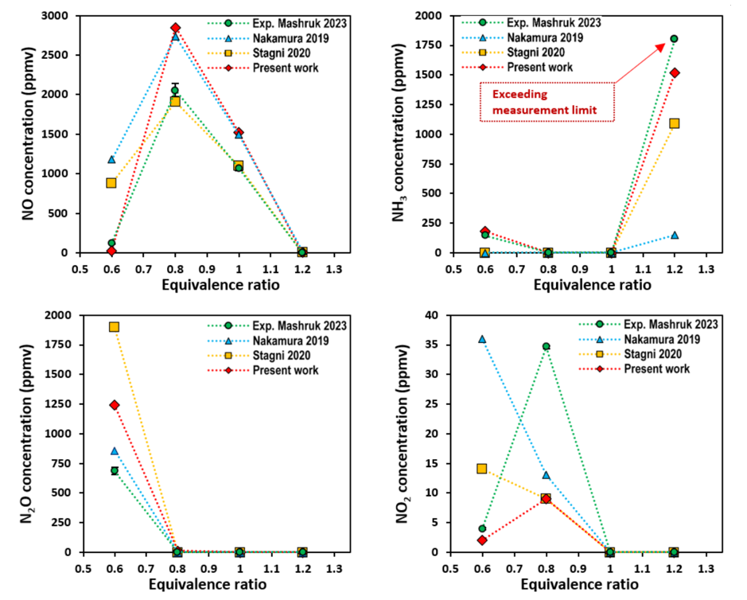
Example 4: San Diego mechanism for NH₃/H₂ flames
Experimental emission data from a swirl-burner design (Cardiff).
70/30 NH₃/H₂
RANS CFD simulations
Ovepredicts NO at ϕ=0.8 and 1.0, but correct at 0.6
Describes NH₃ slip accurately in the whole ϕ range.
Overpredicts N₂O at ϕ=0.6
Qualitative agreement for NO₂
Alnasif, A., Jojka, J., Papp, M., Szanthoffer, A.G., Kovaleva, M., Turányi, T., Mashruk, S., Valera-Medina, A. and Nagy, T. (2025), Journal of Ammonia Energy, 3(1),

Slide 43
Combustion system optimized with Optima(++)
2012 Theory, H₂ (2 reactions from IDT) Int. J. Chem. Kinet. 44, 284
2012 cyclohexane/1-hexene (only ST) Energy 43, 85
2014 ethyle iodide Int. J. Chem. Kinet. 46, 295
2015 H₂ Combust. Flame 161, 2219
2016 H₂/CO Int. J. Chem. Kinet. 48, 407
2016 methanol Int. J. Chem. Kinet. 48, 423
2017 MeOH and HCHO Combust. Flame 186, 45
2020 H₂/NOx Fuel 264, 1–11.
2017 ethane (only HPST) Proc. Combust. Inst. 36, 691
2024 pentanes isomers Proc. Combust. Inst. 40, 105408
2025 ethylene Combus. Flame 273, 113976
2025 NH₃/H₂ for CFD J. Ammonia Energy 03, 054
2025 3 heptene isomers Combust. Flame 280, 114409
2024 H₂/CO/MeOH/NOx Fuel 375, 132544
2025 thermal DeNOx Int. J. Chem. Kinet. 57, 434
Comprehensive optimization studies in preparation:
n-pentanol, large alkanes, ammonia, NOx reburning
M.Papp, T.Varga, Á. Busai, I.G. Zsély,T. Nagy, T. Turányi, Optima++ v. 2.5 (2025)
The Optima++ code and most of the optimized mechanisms are available from respecth.hu.

Slide 44

Optima++ development and application
Additional past members
  Tamás Varga
  Carsten Olm
  Róbert Pálvölgyi
  Ágota Busai
  Simret Kidane Goitom
  New members
  László Horváth
  Chunping Chang
  Collabs:
  Henry J. Curran and
  Pengzhi Wang (Galway)
  Agustin Valera-Medina and
  and Ali Alnasif (Cardiff)
Back row: Peng Zhang, Tibor Nagy, László Kawka, Márton Kovács, András G. Szanthoffer
Fron row: Boyang Su, Éva Valkó, Máté Papp, Tamás Turányi, István G. Zsély, Henrik Schuszter

